Slide 1
Miu Schedule And Online Registration System

Slide 2
Team Members
Adam Zecharias
Awet Goitom
Muna Teklemariam
Sirak Ghebrehiwot
Yonas Abraha

Slide 3
Automated MIU scheduler will be an automated schedule builder
application for MIU’s computer professionals’ program. Many years ago,
scheduling of classes and faculty was done with a comparably excel
spreadsheet since there were probably 20-40 students per three entries
every year. The student registration part will be kept as a simple tool for
this project. In short, there was a problem of managing compro student
schedules and allowing them to register for classes. This system affects not
only students, but also administrators and faculty, making the lives of
registrar much easier and well organized and automated.
• Automating the software saves time and money. And it will be expandable
and will be able to handle a large number of students, making it easy,
efficient and reliable.
• This tool will be useful to any university that uses the block system for
offering classes. With small modifications it could also be used for Semester
based programs.
• The Use case Diagram- shows who are the actors and what actions they can
take on the system in a very abstract form.

Slide 4
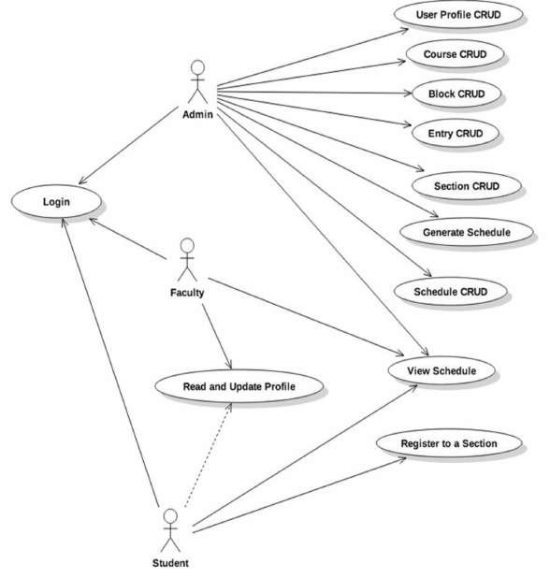
MIU Schedule Use Case model (Diagram)

Slide 5
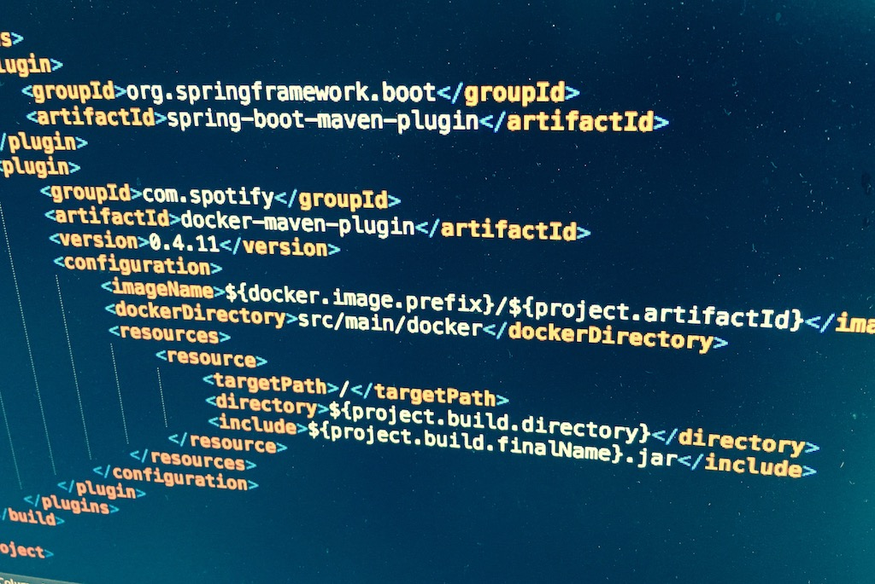
Usecase description

Slide 6
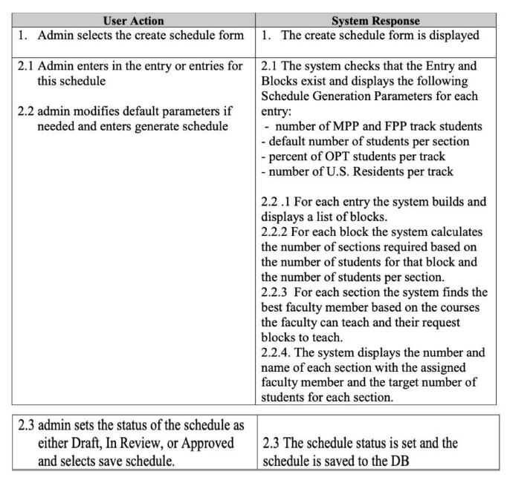
Admin create schedule

Slide 7
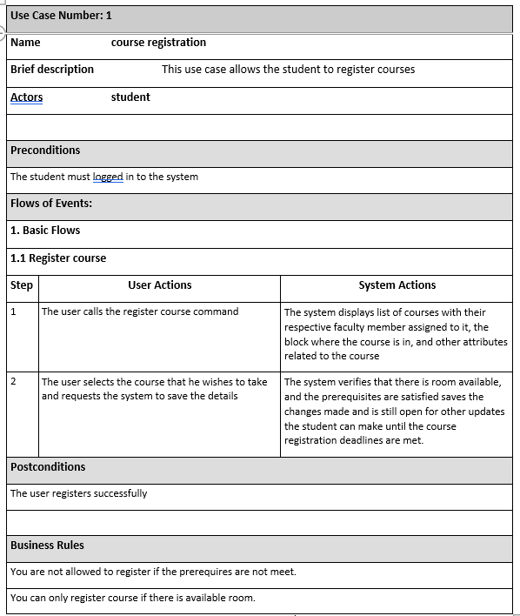
Student course registration

Slide 8
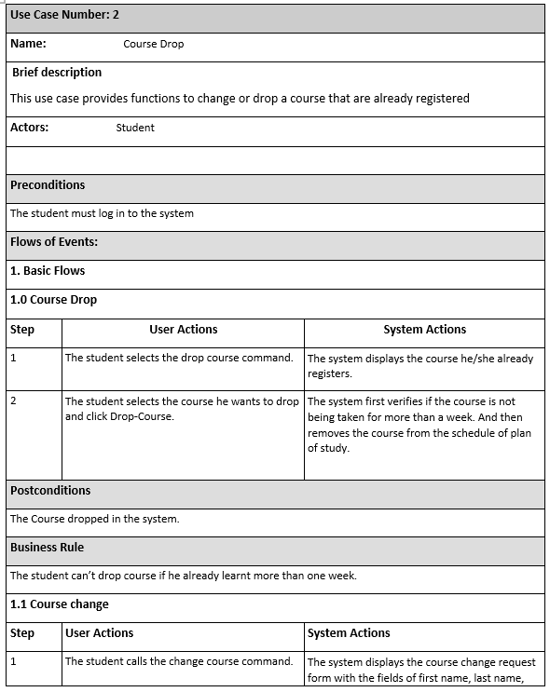
Student Change course

Slide 9
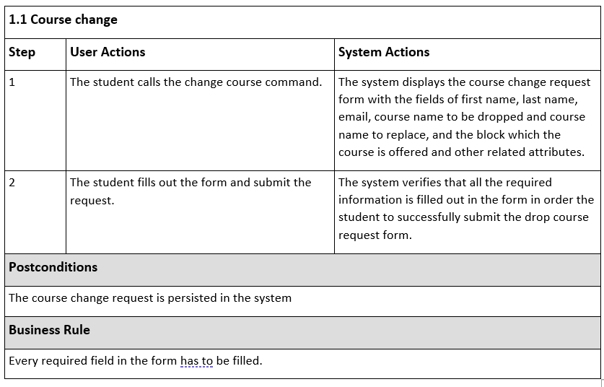
Student Drop Course

Slide 10
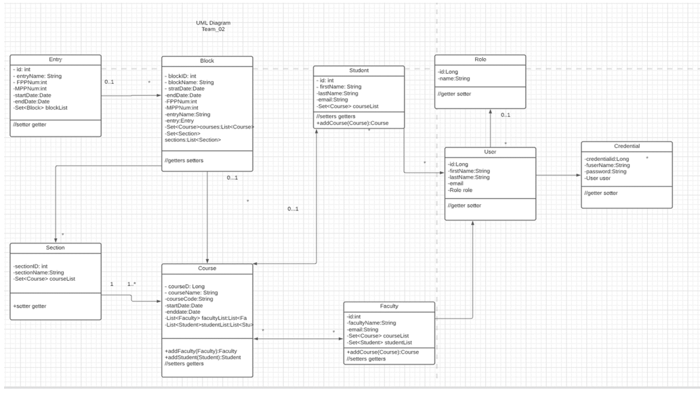
Static Model (Class Diagram)

Slide 11
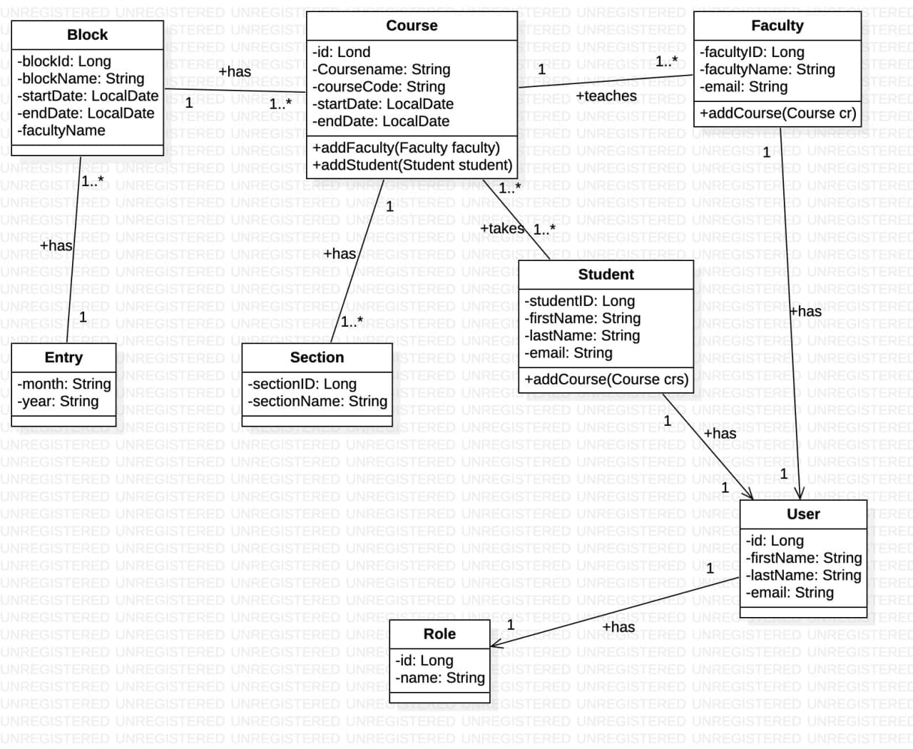
database Design Model (ER-Diagram)

Slide 12
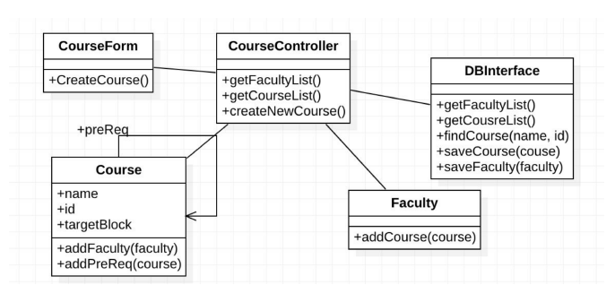
Vopc diagram

Slide 13
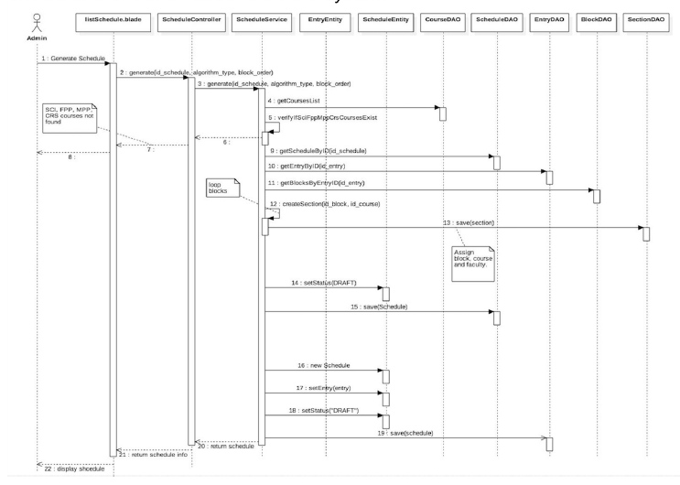
Sequence diagram-Admin action on the system.

Slide 14
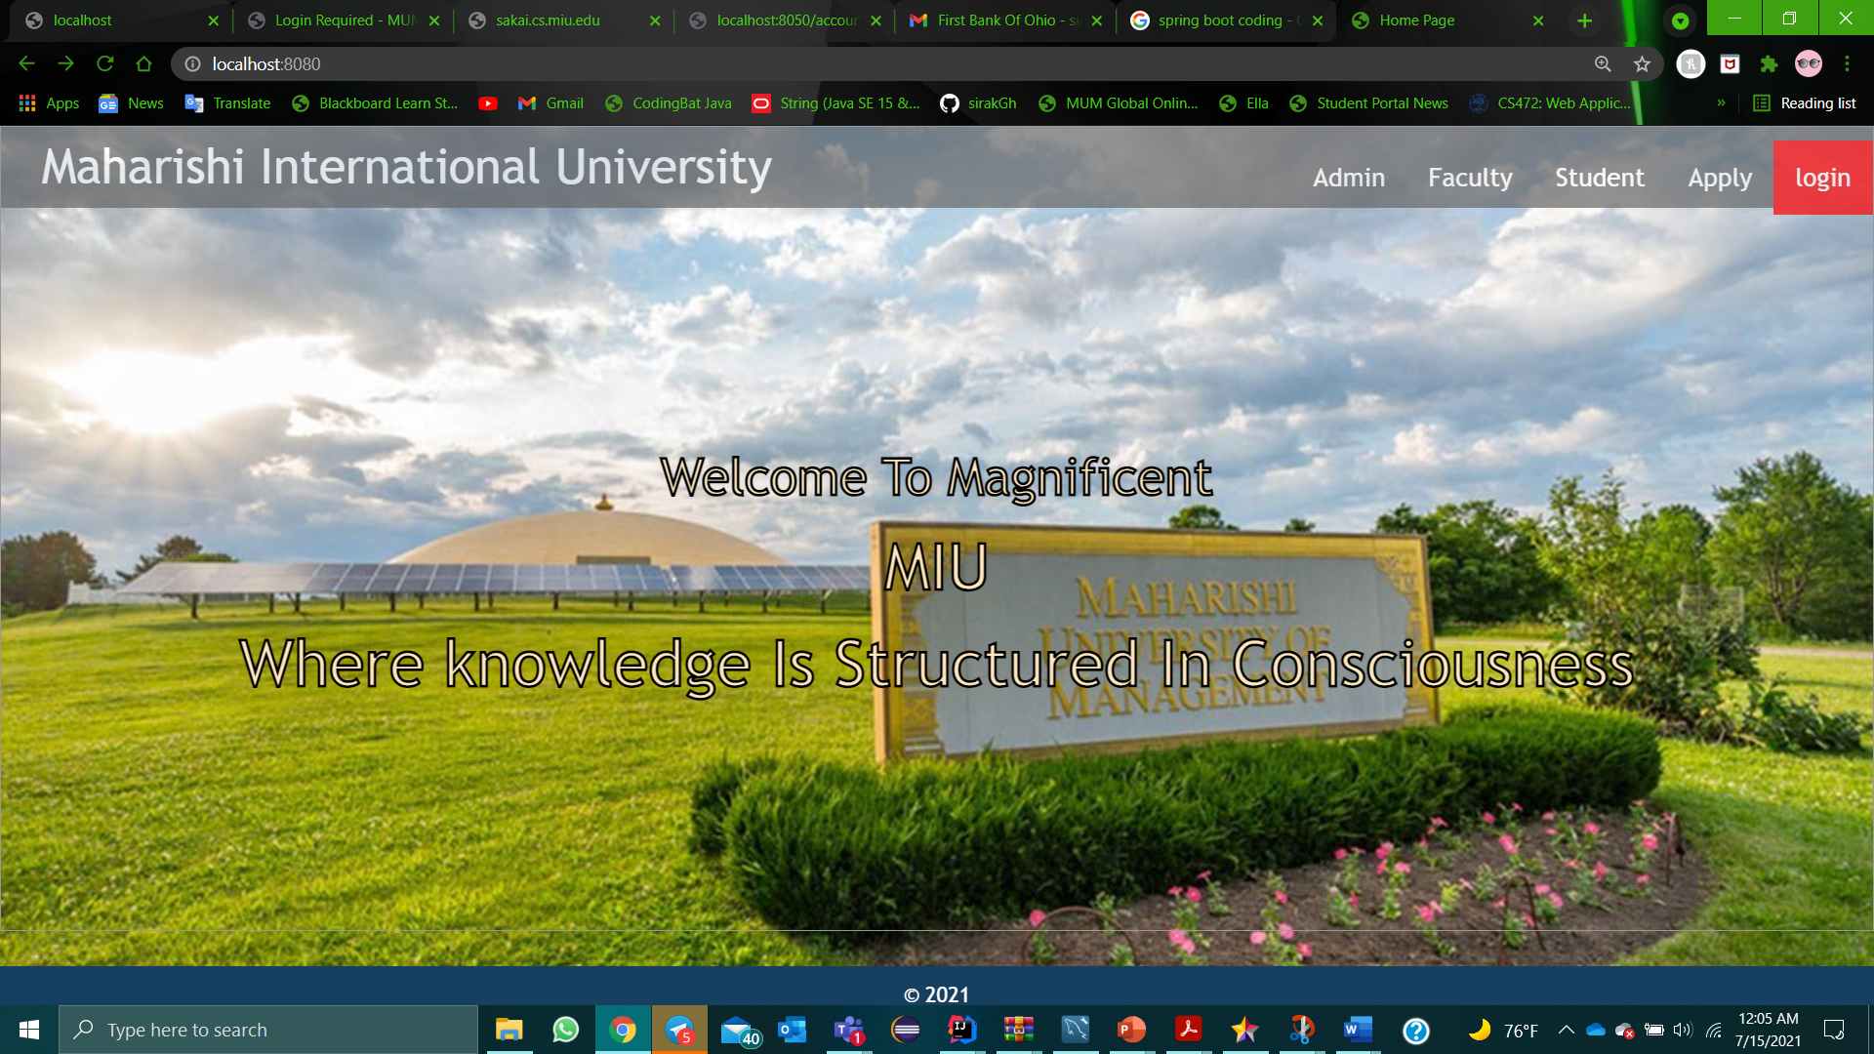
Sample of our demo pages

Slide 15
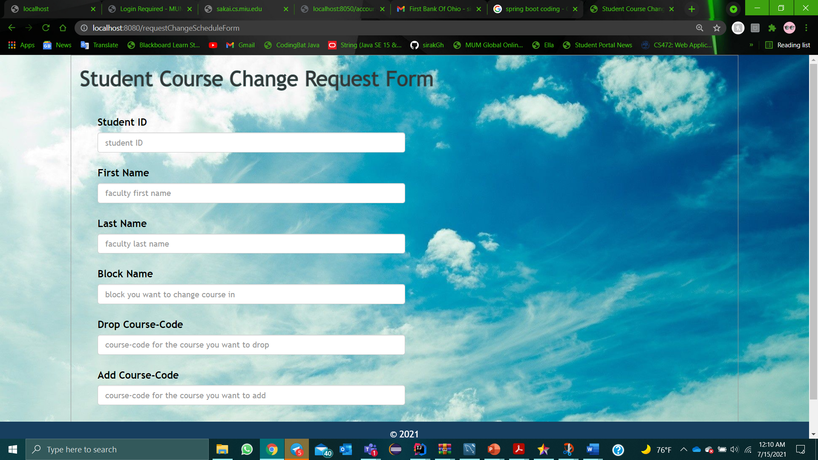

Slide 16



conclusion
In conclusion we have try to implement all the spring boot tools, what we have learned in this course. It is a mind changing knowing the power of Spring Framework. It is manageable and easy to manipulate and develop any software.
Thank you……!!!!!

